Slide 1

FINAL REVIEW DDoS Protection System for Cloud: Architecture and Tool Project Category : RESEARCH
Supervisor Name Dr. Balaji Srikaanth P, AP/NWC Dr. S. Nagendra Prabhu, AP/CINTEL | Batch No. NW000156 Shaurya Singh Srinet – RA2111032010006 Shounak Chandra – RA2111032010026 Charvi Jain – RA2111047010113

Slide 2
Abstract
Increasing cloud adoption heightens the risk of DDoS attacks, threatening service availability and data security.
We propose a scalable DDoS Protection System designed for real-time detection and mitigation in cloud environments.
Utilizes a multi-layered architecture with machine learning to distinguish between malicious and legitimate traffic patterns.
Ensures seamless integration across various cloud platforms while maintaining performance and minimizing false positives.
Aligns with industry security standards to safeguard data integrity and service continuity.

Slide 3
Introduction
Proposed Solution:
Cloud-native DDoS Protection System using machine learning for real-time anomaly detection and automated traffic filtering.
Differentiates between malicious and legitimate traffic to ensure continuous service.
Key Features:
Scalable and adaptable to various cloud architectures.
Compliant with industry standards for data integrity and security.
Impact:
Handles high traffic volumes (many Mbps) while maintaining optimal cloud resource utilization.
Ensures uninterrupted user experience with no service degradation or increased latency.
Adapts over time, improving detection and response by learning emerging attack patterns.

Slide 4
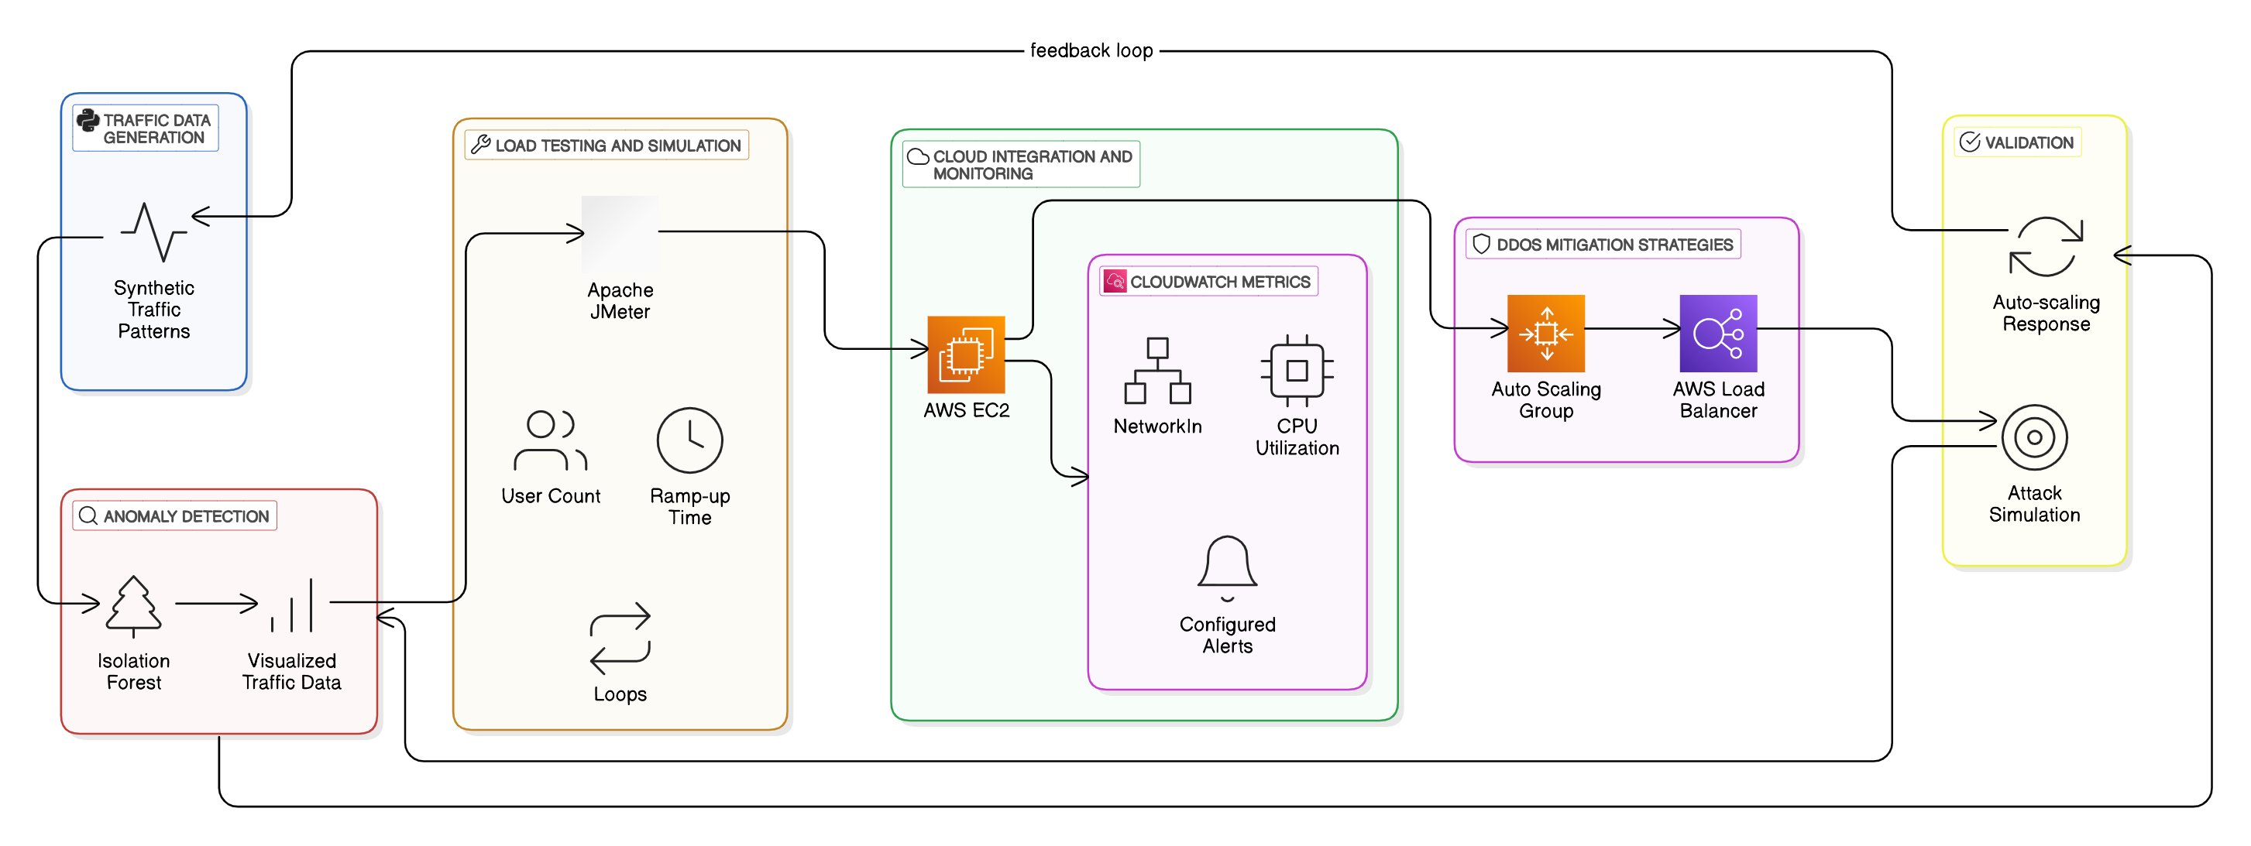
Architecture Diagram

Slide 5
Progress and Updates
Machine Learning Model Optimization:
Improved feature selection and hyperparameter tuning for the Isolation Forest algorithm.
Achieved better performance in detecting both volumetric and application-layer DDoS attacks.
Real-Time Filtering:
Integration of the model into live cloud environments has commenced.
Triggered mitigation actions based on detected anomalies, including AWS Auto-Scaling and Load Balancing.

Slide 6
Traffic Simulation and Performance Testing
Traffic Simulation with JMeter:
Expanded traffic simulation scenarios to include more complex attack patterns and higher volumes.
Realistic traffic generation was tested to ensure that the model can identify DDoS anomalies under various conditions.
Performance Testing:
Successfully tested the system's performance under different DDoS attack loads.
Results suggest that the system can scale well under significant traffic spikes.

Slide 7
Next Steps
Model Optimization & Refinement:
Further improve detection accuracy by incorporating new features and attack data.Focus on reducing false positives during high-traffic periods.
Cloud Integration and Real-Time Testing:
Expand real-time integration with cloud platforms.
Implement additional mitigation strategies, including network-level protections.
Comprehensive Stress Testing:
Perform additional performance testing with larger datasets and varied DDoS scenarios.
Evaluate the system's robustness and make necessary adjustments to enhance scalability.

